Slide 1
BUAN 6357 Advanced Business Analytics Using R
Movie Recommender System
- By Animesh Kansal (axk169531)

Slide 2
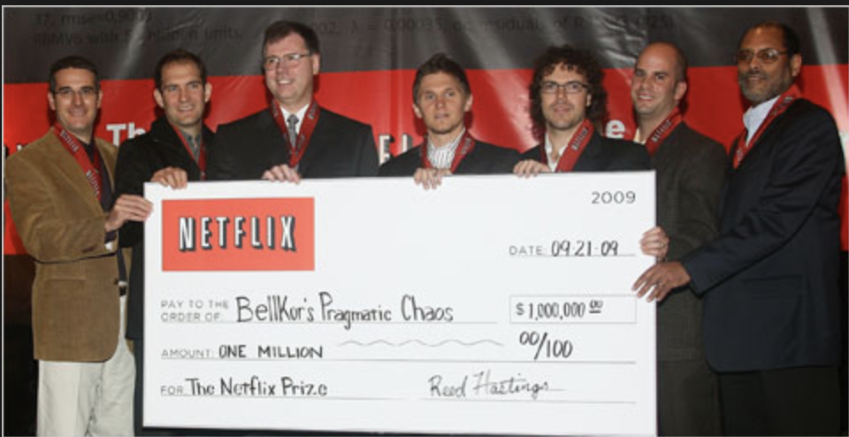
Netflix $1M cash prize

Slide 3
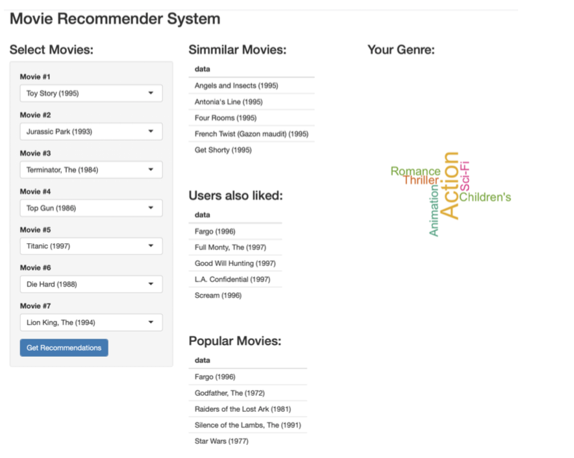
Shiny App: Link

Slide 4
Data set:
I used the 100k MovieLense ratings dataset.
The data is available on MovieLens web site (movielens.umn.edu).
The data was collected from 1997 through 1998.
It contains about 100,000 ratings (1-5)
It has 943 users with 1664 movies.

Slide 5
Algorithms used: (recommenderlab package in R)
Most Popular recommendation
Item Based Collaborative Filtering
User Based Collaborative Filtering

Slide 6
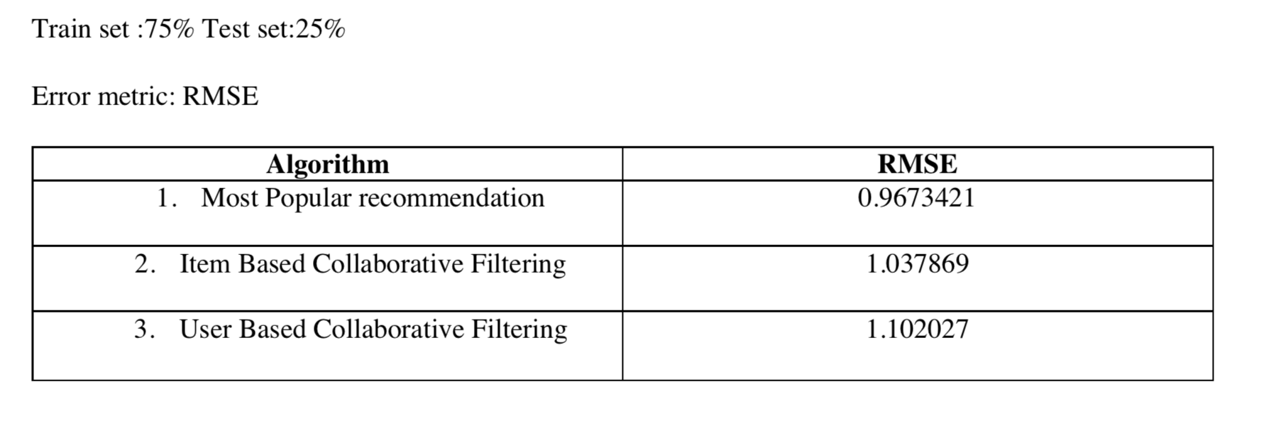
Recommender System Evaluation/performance:

Slide 7
Thank you

